Slide 1
Options and Futures
“Frank, 10,000 ANC at 46. Let me know how the options open, OK?”
– Bud Fox, Wall Street (1987)

Slide 2
Options/Futures
Options and futures are advanced trading instruments
Can be used to speculate or hedge
If used to speculate very risky
Hence have to have a margin account to trade

Slide 3
Option

Slide 4
Options
Essentially, an option is a coupon
Gives you the right to buy/sell @ a price
However, only for a limited time
Two major options:
‘Call’ options give you the right to buy
‘Put’ options give you the right to sell

Slide 5
Option Terminology
Strike (Exercise) Price
Price you get to buy/sell at ($10)
Expiration Date
Last date (or only day) you can use the option
Option Price (premium)
Price for the right to buy and sell. (Not free)

Slide 6
Option Terminology (cont.)
Terminal Value (on last day of life)
Do NOT have to exercise (i.e. use) an option
If you can get for less than $10, just throw out coupon
Call Terminal Value: Max(0, $ - strike)
Put Terminal Value: Max(0, strike - $)

Slide 7
Option Terminology (cont.)
Intrinsic Value (before last day)
Value of option if expired today
Time Premium
Extra you are willing to pay because stock can go up

Slide 8
More Terminology
‘In the money’ if the intrinsic value > 0
‘At the money’ if strike and price are equal
‘Out of the money’ if price < strike
At and Out of money have intrinsic values of 0

Slide 9
More Terminology (cont.)
Buy/go long an option
Gives the right to buy
Sell/go short/write an option
Means you are GIVING the right
Opposite payouts

Slide 10
Call Payoff at Expiration for Buyer

Slide 11
Call Payoff at Expiration for Seller

Slide 12
Put Payoff at Expiration for Buyer

Slide 13
Put Payoff at Expiration for Seller

Slide 14
Payoff vs. Profit
Of course, payoff does not equal profit
Remember you had to pay for the option
Call Breakeven:
Underlying $ = Strike + Premium Paid
Put Breakeven:
Underlying $ = Strike - Premium Paid

Slide 15
Profit for Call Owner

Slide 16
Profit for Call Writer

Slide 17
Cost of an option
Premium depends on several factors (>)
Strike Price (- for call, + for put)
Current value of underlying security (+ for call, - for put)
Interest rate (- for both)
Volatility of underlying security (+ for both)
Time to Maturity (+ for both)

Slide 18
Pricing Options
Options are generally priced in two ways:
Binomial Tree
Black-Scholes option pricing formula
Modifications to Black-Scholes
Lots of theories on option mispricing

Slide 19
American vs. European
There are two main types of options
American options can be exercised at any time
European options can only be exercised on the expiration date
Can always ‘exercise’ by selling
In most cases, the early exercise option is ‘worthless’

Slide 20
Pros #1: Amazing Flexibility

Slide 21
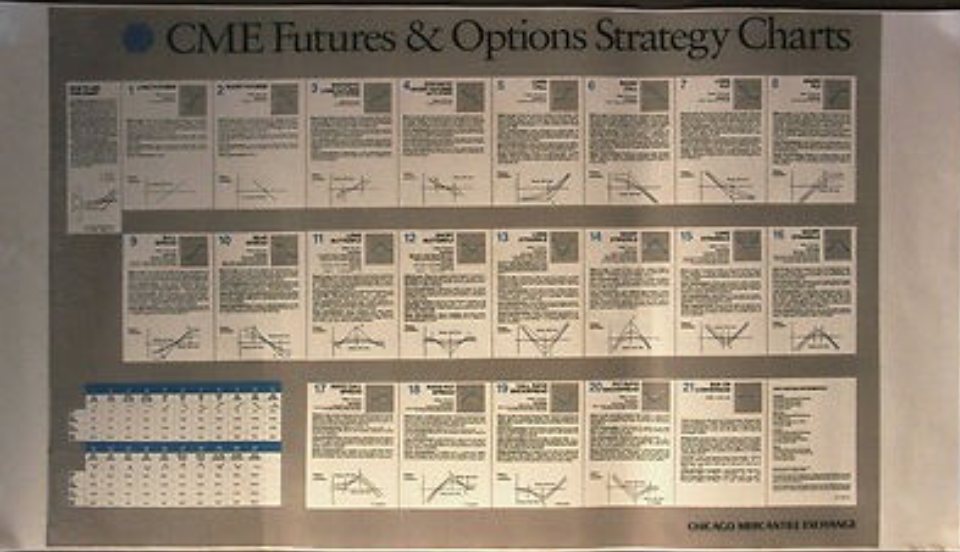
Pros #1: Amazing Flexibility

Slide 22
Pro #2: Making Profit

Slide 23
Stock vs. Option returns

Slide 24
Big Con: Timing
Strike at $30? Sorry!

Slide 25
Con #2: Cost
(9.75 – 9.15)/9.15 =6.6%

Slide 26
Basic Strategy #1: Straddle
You think price is going to change a lot
But don’t know which direction
Can create a straddle
Go long a call option
Go long a put option
Same strike

Slide 27
Tesla Example
Not sure if Elon is going to tweet something good or bad
Go long
$345 Call for $6.50
$345 Put for $7.00
Let’s see the payoffs and profit

Slide 28
Straddle Payoff

Slide 29
Straddle Profit

Slide 30
Basic Strategy #2: Strangle
You think price is going to change a lot
But don’t know which direction
Straddle to expensive
Can create a strangle
Go long a call option
Go long a put option
Different strike prices

Slide 31
Tesla Example
Not sure if Elon is going to tweet something good or bad
Go long
$347.50 Call for $5.40
$340.00 Put for $5.01
Let’s see the payoffs and profit

Slide 32
Strange Payoff

Slide 33
Strange Profit

Slide 34
Strategy #3: Short Straddle
You think price is NOT going to chg a lot
SEC settlement will shut up Elon
Can create a short straddle
Go short a call option
Go short a put option
Same strike

Slide 35
Tesla Example
Not sure if Elon is going to tweet something good or bad
Go long
Sell $345 Call for $6.50
Sell $345 Put for $7.00
Let’s see the payoffs and profit

Slide 36
Short Straddle Payoff

Slide 37
Short Straddle Profit

Slide 38
Strategy #4: Covered Call
You think that either:
The stock price isn’t going to go up too much
Or you want to goose your return
Can go with a covered call strategy
Go long the stock
Sell a call option
Usually sell a call at a strike > than $ now

Slide 39
Covered Call Payoffs

Slide 40
Covered Call Profit

Slide 41
Futures
Contracts where 2 parties will something for $
Stocks
Bonds
Currency
Wheat
Gold
Bitcoin

Slide 42
Futures
Futures are standardize contracts
Amounts
Delivery
Delivery Month
Collateral
Futures really aren’t different from trading a stock

Slide 43
Futures (cont.)
Note: no money changes hands today
Just agree to exchange money
In practice, must put up some collateral
Amount depends on:
Dollar amount of contract
Volatility of the value

Slide 44
Contract Examples

Slide 45
Contract Examples (cont.)

Slide 46
Contract Examples (cont.)

Slide 47
Contract Examples (cont.)

Slide 48
Long/Short
Buyer agrees to BUY the item on that day
Seller agrees to SELL the item on that day
Unlike options, HAVE TO DO IT
So price change is symmetric

Slide 49
S&P 500 Future

Slide 50
Long S&P 500 Future

Slide 51
Short S&P 500 Future

Slide 52
Open Interest vs. Volume
Like other financial instruments, futures trade daily
However, supply of futures is not fixed
Contracts can be created a destroyed
i.e. if a new ‘seller’ and new ‘buyer’ trade, then a new contract is created

Slide 53
Open Interest Example
Action | Open Interest
Party A buys 1 Euro Future Party B sells 1 Euro Future | 1
Party C buys 5 Euro Futures Party D sells 5 Euro Futures | 6
Party A sells 1 Euro Future Party D buys 1 Euro Future | 5
Party E buys 5 Euro Futures Party C sells 5 Euro Futures | 5

Slide 54
Why Trade Futures?

Slide 55
Why Trade Futures? (cont.)

Slide 56
Why Trade Futures? (cont.)

Slide 57
Futures vs. Options
Futures
Virtually costless
No timing issue
Allow you to add leverage
Options
A million different strategies
Allow you upside with little downside

